Slide 1
Empowering and enabling the logistics industry globally.
Behavioral Design Patterns
Nancy Li
Software Developer
11 Aug 2023

Slide 2
Design Patterns
Behavioral Design Patterns
Creational Design Patterns
Structural Design Patterns
Notes:
Design patterns are typical solutions to commonly occurring problems in software design.
When a solution gets repeated over and over in various projects, someone eventually puts a name to it and describes the solution in detail.
That’s basically how a pattern gets discovered.
You can follow the pattern details and implement a solution that suits the realities of your own program.
Design patterns are divided into three main categories
The first category is Creational patterns, for which I made a presentation last year.
The second is Structural patterns. That's what I want to talk about today.
Structural patterns explain how to assemble objects and classes into larger structures, while keeping these structures flexible and efficient.
//Creational patterns provide object creation mechanisms that increase flexibility and reuse of existing code.
//Behavioral patterns take care of effective communication and the assignment of responsibilities between objects.

Slide 3
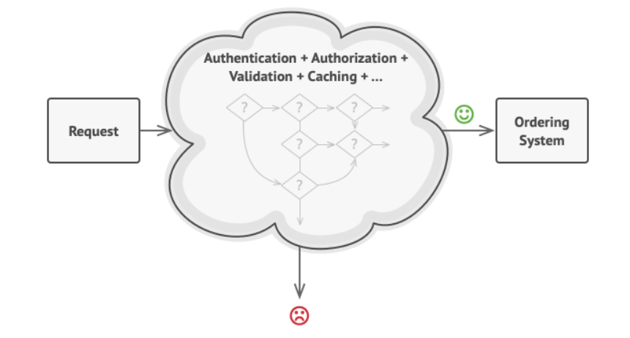
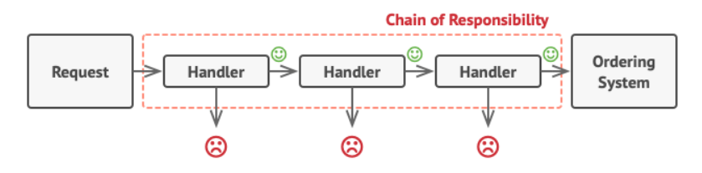
1. Chain of Responsibility

Slide 4
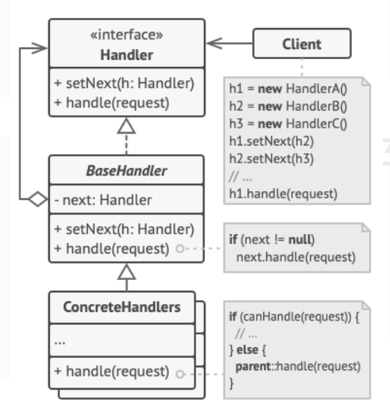
1. Chain of Responsibility
Handler
Base Handler
Concrete Handlers

Slide 5
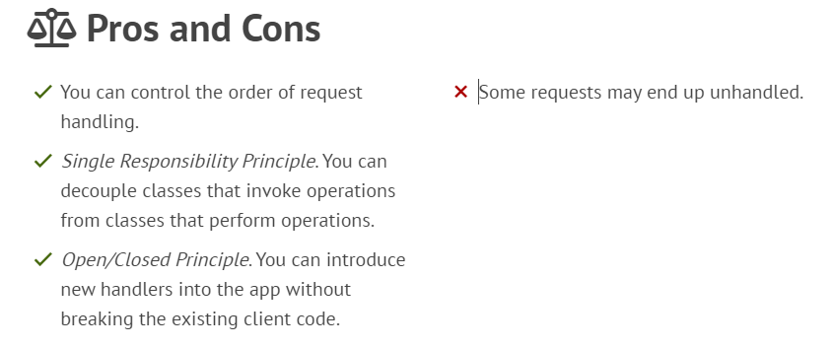
1. Chain of Responsibility

Slide 6
1. Chain of Responsibility

Slide 7
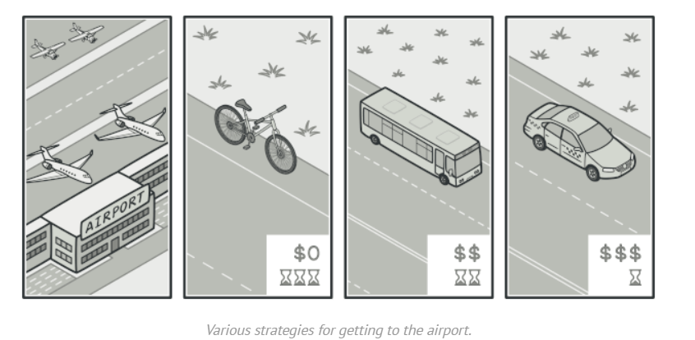
2. Strategy

Slide 8
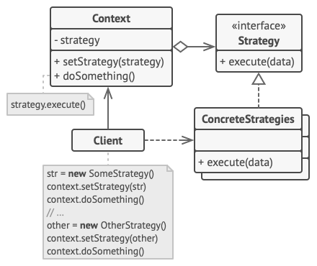
2. Strategy
Context
Strategy
Concrete Strategy

Slide 9
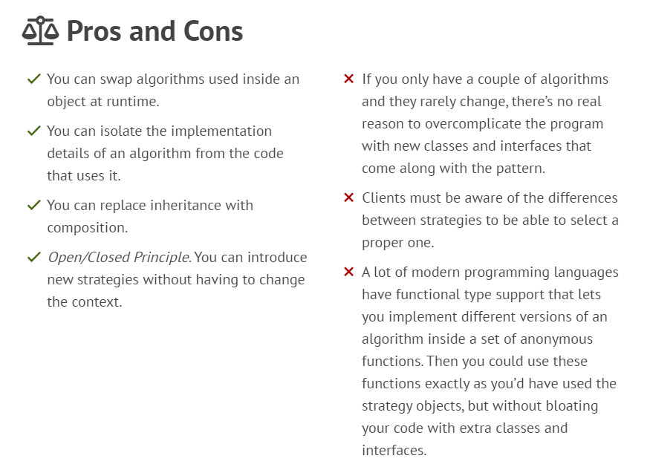
2. Strategy

Slide 10
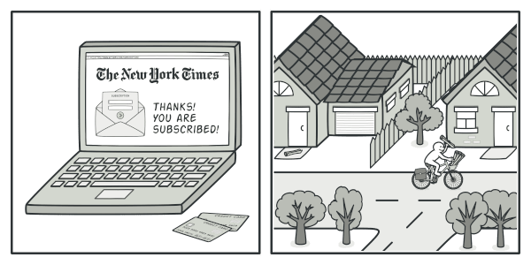
3. Observer

Slide 11
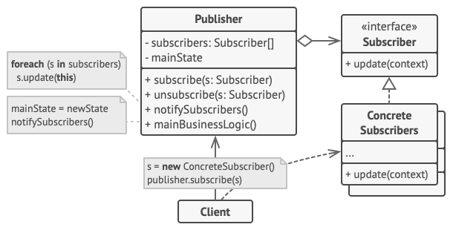
3. Observer
Publisher
Subscriber
Concrete Subscribers

Slide 12
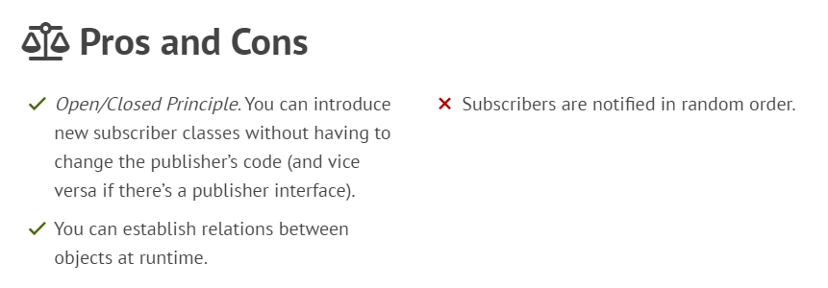
3. Observer

Slide 13
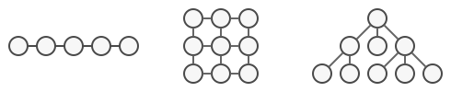
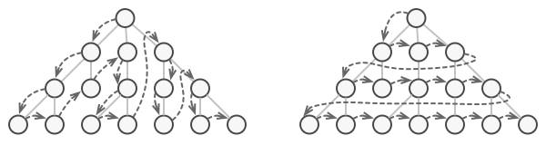
4. Iterator
The same collection can be traversed in several different ways.

Slide 14
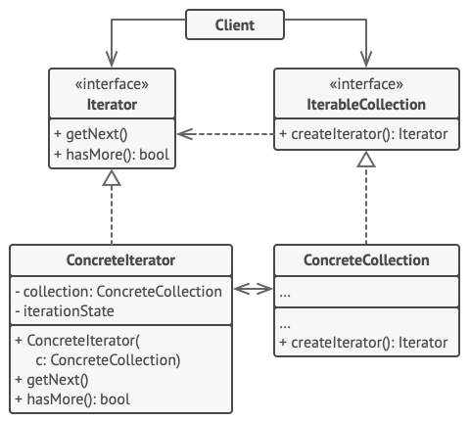
4. Iterator
Iterator
Concrete Iterators

Slide 15
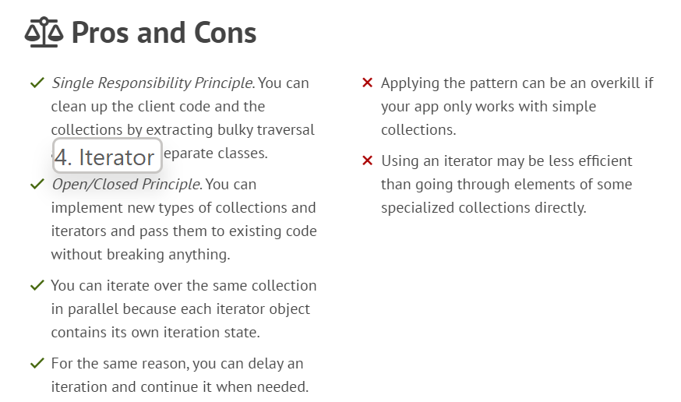
4. Iterator

Slide 16
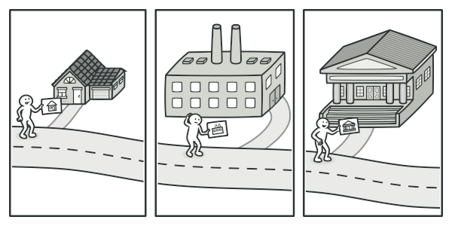
5. Visitor

Slide 17
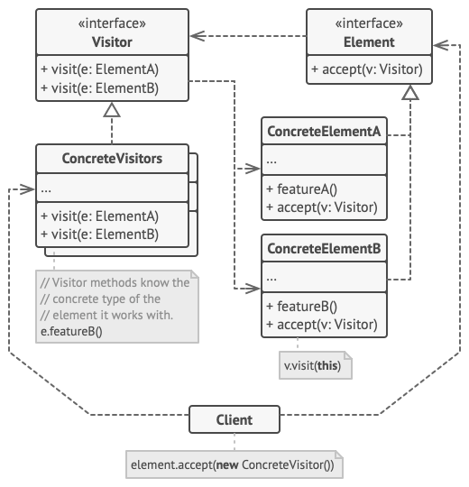
5. Visitor
Element
Concrete Visitors
Visitor
Concrete Elements

Slide 18
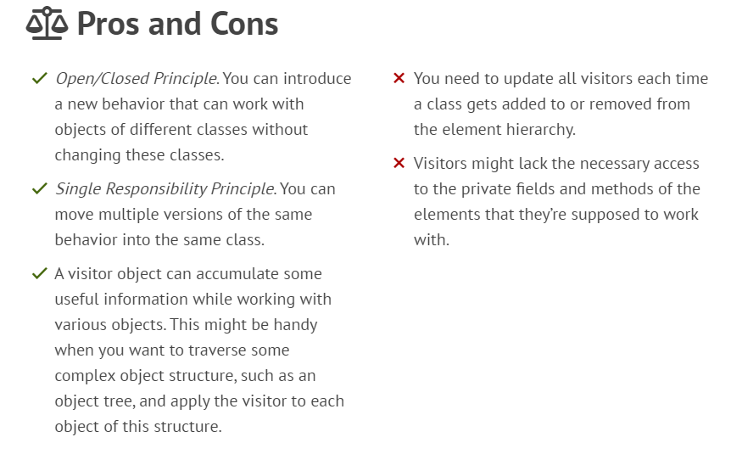
5. Visitor

Slide 19
Behavioral Design Patterns
1. Chain of Responsibility
2. Strategy
3. Observer
4. Iterator
…….
5. Visitor
Notes:
These are the five Structural Design Patterns.
I hope it can be helpful to everyone.

Slide 20
Q&A

Slide 21
Empowering and enabling the logistics industry globally.
Thank You!

